Slide 1

Tior Games Data Warehouse
By H.A.M

Slide 2
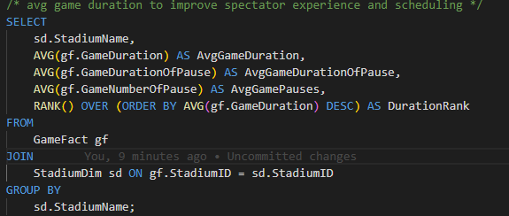
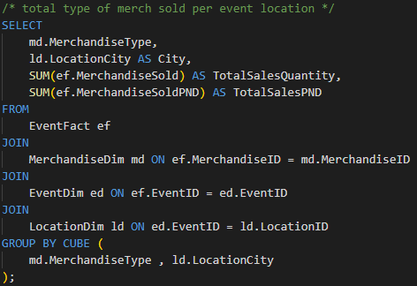
T-SQL Queries
Query 1
Query 2
This query looks at the total type of merch sold per event location.
Tior games can adjust inventory distribution of the merchandise type to maximise sales.
In the 2nd query we look at the average game duration.
This helps in optimising scheduling and spectator engagement.

Slide 3
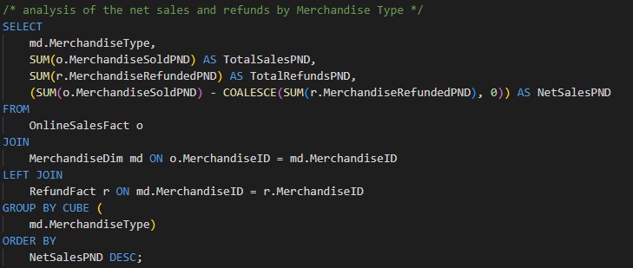
T-SQL Queries - cont
Query 3
Query 4
We go on to explore the net sales by merchandise type.
Tior games could decide to discontinue low-net sale items and focus on high profitable products.

